Slide 1

Aniruddha
(1st Year)
<Full Stack>
Rishabh M.
(2nd Year)
<Front End>
Gita
(1st Year)
<IoT>
Rishabh V.
(3rd Year)
<Android Development>
Aaishika
(1st Year)
<Graphics & UI>
TEKMUX 3.0

Slide 2


PROBLEM STATEMENT
62 million tonnes annually averages out to 450 grams of waste per person per day. However, there is a lot of variability in per capita waste generation in India, daily household municipal solid waste (MSW) generation ranges from 170 grams per person in small towns to 620 grams per person in large cities.
Garbage is everywhere, and they are always more in the cities!

Slide 3

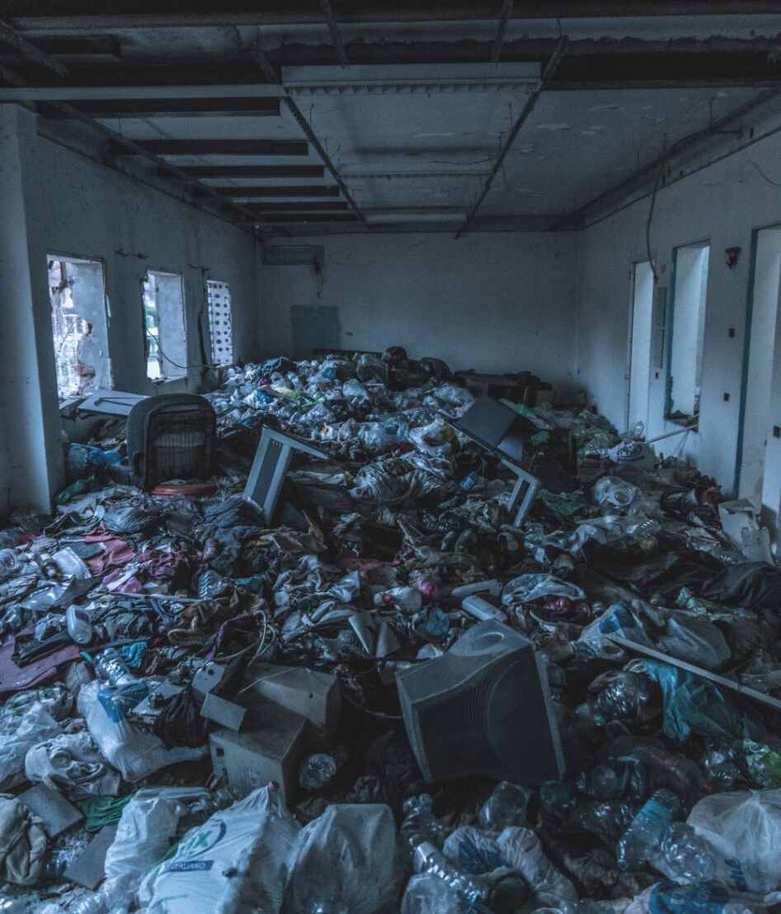
With rapid urbanisation, the country is facing massive waste management challenge. Over 377 million urban people live in 7,935 towns and cities and generate 62 million tonnes of municipal solid waste per annum. Only 43 million tonnes (MT) of the waste is collected, 11.9 MT is treated and 31 MT is dumped in landfill sites.
STATISTICS
More than three-fourth of solid waste management budget is allotted to collection and transportation, leaving very little for processing or resource recovery and disposal.

Slide 4

A closer look at the actual money spent by civic departments over Garbage Disposal
From 2016-17
Unused Funds
43%
A report by Times Of India
For instance, Rs 237.4 crore was allocated in the 2016-17 budget for the
solid waste management department project works. The estimate was later
revised to Rs 122 crore, but finally only Rs 69.7 crore was spent.
Used Funds
57%

Slide 5

WE SOLVE THIS PROBLEM
WITH OUR BRAINCHILD

Slide 6


TEKMUX 3.0
FUSION
#BEGONE_GARBAGE
TEAM HACKATHANOS

Slide 7
What exactly is Fusion?
Fusion will be a fully automatic garbage monitoring system that will be implemented in cities, consisting of sensors that will transmit data in real time about the status of Garbage Bins to the given municipal cooperation and raise an alert if a bin is full and requires garbage pick up.
Our Solution to Effective Waste Management

Slide 8
WHAT MAKES A FUSION
COMPONENTS
FEATURES
Gas Sensors, LDR Sensors, Arduino Board, Raspberry Pi, Monitor.
Reduces effectively the cost of transportation of garbage and ensures that garbage bins don't overflow and spread germs.
#BEGONE_GARBAGE
IMPACT
TEAM HACKATHANOS
Exponentially reduces the cost of garbage collection and significantly adds time and money for processing and resource recovery.
Yes, we make the Fusion!

Slide 9

WHAT HAPPENS WHEN FUSION SENSES THAT A BIN IS
"FULL or FOUL"
PASSES A SERIAL DATA TO THE RASPBERRY PI
API PROCESSES DATA
OUTPUT API RETURNS DATA
A Sample Timeline
The Web API extracts the required data from the tags and writes to the MySQL database
The web server and android app receive data from an endpoint and raise an alert
A python linux daemon reads the serial data and updates it to a web API

Slide 10

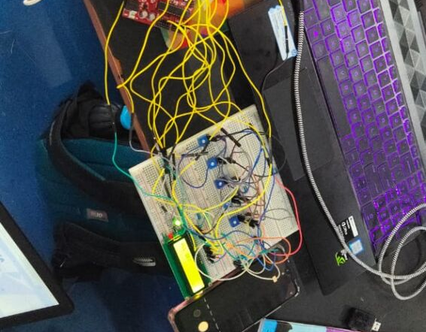
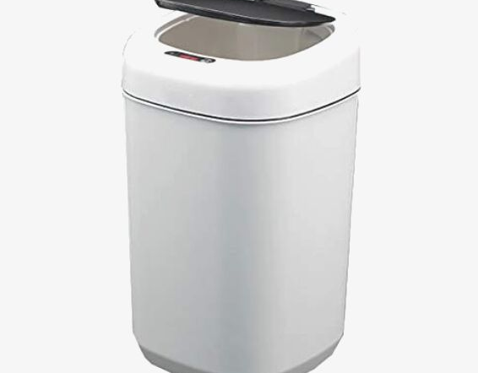
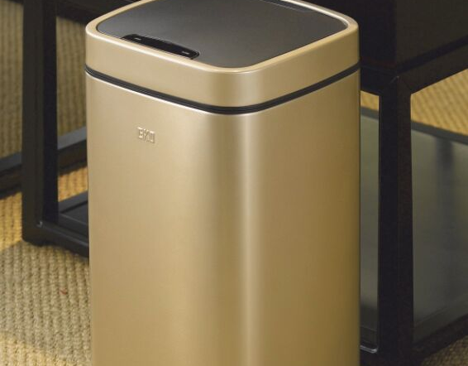
COMPARING OTHER SMART BINS
WHY YOU SHOULD IMPLEMENT FUSION
FUSION (660L)
REETRIX (9L)
EKO (6L)
Fusion Prototype
Cost: 2000 Rupees
Only Motion Sensor
Cost: 4995 Rupees (Amazon)
Only Motion Sensor
Cost: 7750 Rupees (Amazon)

Slide 11
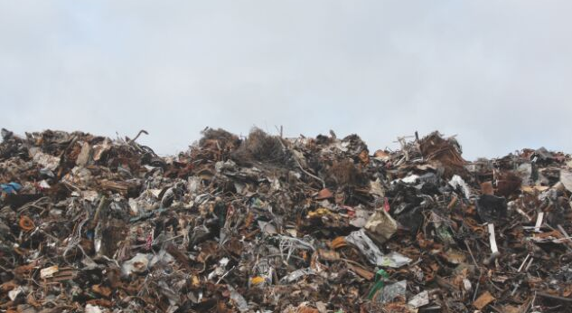
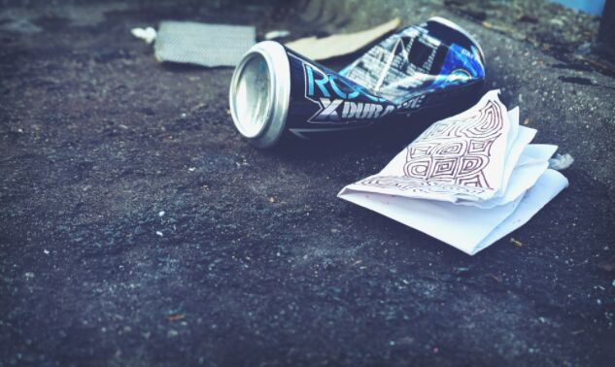
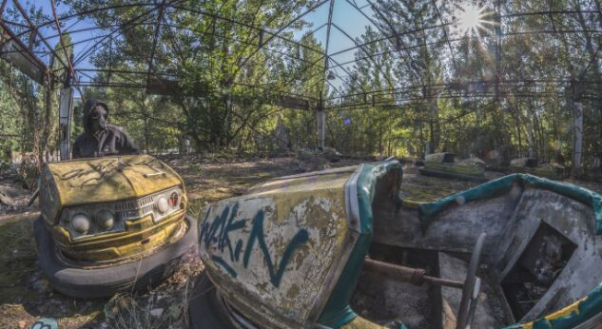
FUTURE PROSPECTS OF FUSION
Fusion can be designed to simultaneously monitor multiple garbage bins from one endpoint.
Fusion can also be designed to directly send GPS coordinates to the Mobile Devices of the Garbage Collectors & reduces communication time from the authorities to Ground Persons.
Fusion can be reduced to the size of a personal appliance for domestic use as well.

